Slide 1
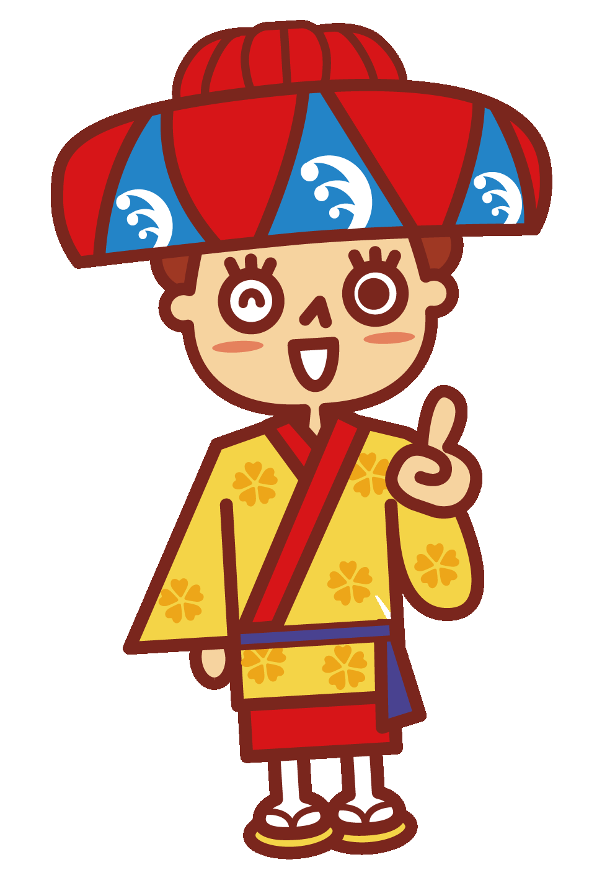
Worksheet for Senior high school students
Let’s try to search and answer Q1-5.
Q1
Please introduce the characteristics of Okinawa food culture.
answer
Q2
What is the collaboration with foreign cuisine in Okinawa？
answer
Q3
What is the patron saint of Okinawa called “SHISA”？
answer
Q4
Please make a plan that goes around all 9 places of the world heritage.
answer
Q5
What kind of place is Itiomote Ishigaki National Park?
answer

Slide 2
Worksheet for Senior high school students
Let’s try to search and answer Q1-5.
Q1
What role does coral reef play in the ocean？
answer
Q2
What will happen if corals die？
answer
Q3
What kind of country was Okinawa like in the past?
answer
Q4
Why are the US military bases concentrated in Okinawa?
answer
Q5
Where can you learn about local culture in Okinawa and what can be learned?
answer

Slide 3
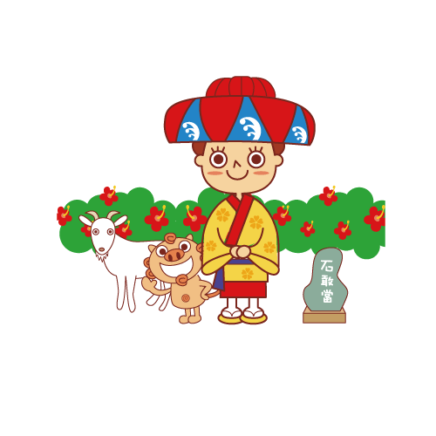
Worksheet for high school students
Topic discussion
Q1
Which aspect of Okinawa are you interested in？
Q2
What do you want to know more about Okinawa?
Q3
Do you have any doubts about Okinawa？
Q4
Do you have any ideas or items want to experience？
Q5
Decide on your own learning plan.

