Slide 1
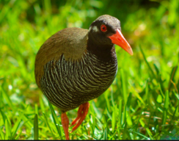
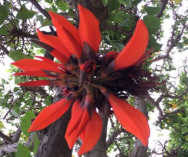
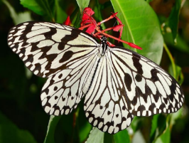
Worksheet for elementary school students
Let’s try to search and answer Q1-5.
Q1
Please fill in the blanks below about the climate of Okinawa.
Proposed answer
The average annual temperature in Okinawa is（ 22～23 ）degree.
The annual humidity in Okinawa is（ 74 ） ％.
The feature of Okinawa’s climate is（ hot and humid subtropical climate). It is warm all year round.
Q2
Please fill in the blanks below regarding the geography of Okinawa.
Proposed answer
From the easternmost point to the westernmost point of Okinawa is about（ 1,000 ）km.
From the northernmost point to the southernmost point of Okinawa is about（ 400 ）km.
There are about（ 160 ）islands in Okinawa and （ 47 ）inhabited islands.
The southernmost inhabited island in Japan is（ Hateruma Island）.
Q3
Please fill in the blanks below regarding the event of Okinawa.
Proposed answer
The main event that recognized a Guinness World Record is held on the second weekend of ( October ) each year, is called ( Naha Great Tug-of-War Festival ) that the history and tradition of more than ( 400 ) years. It uses a large tug of war with total length of ( 200 ) meters is pulled by over 15,000 people.
Q4
Please fill in the blanks below about the natural monument of Okinawa.
Proposed answer
（ Yanbaru kuina ）
（Deigo）
（Oogomadara）
Q5
Let’s study Okinawa local language.
Proposed answer
hello → Haisaiはいさい（for man） Haitaiはいたい（for woman）
thank you → Nifei-de-biruにふぇーでーびる
delicious → ma-sandoまーさんど cute → tyuraka-giちゅらかーぎ
welcome → menso-reめんそーれ fight → chibariyo-ちばりよー

